Slide 1
My Daily Life
Impressionism

Slide 2
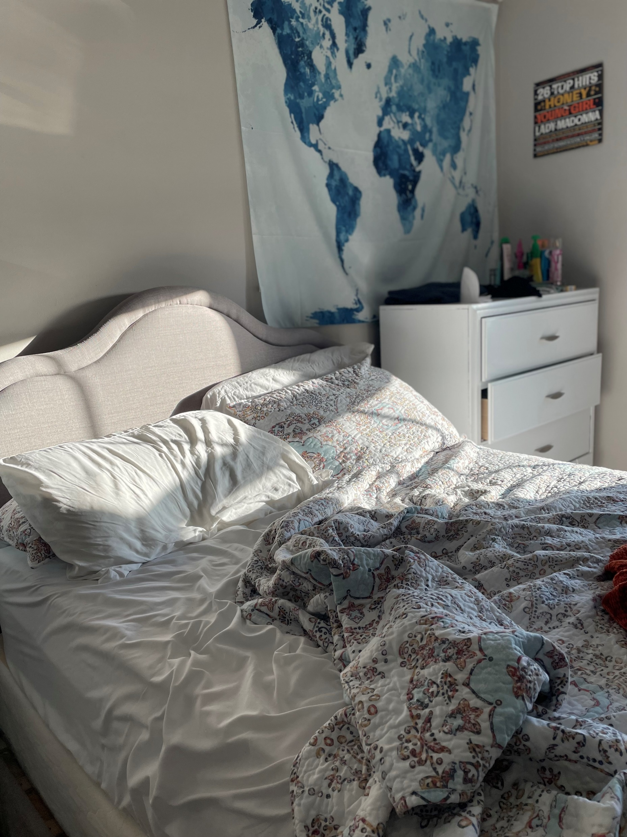
I wake up around 6-7 am with the sun glaring through the window as my natural alarm clock.

Slide 3
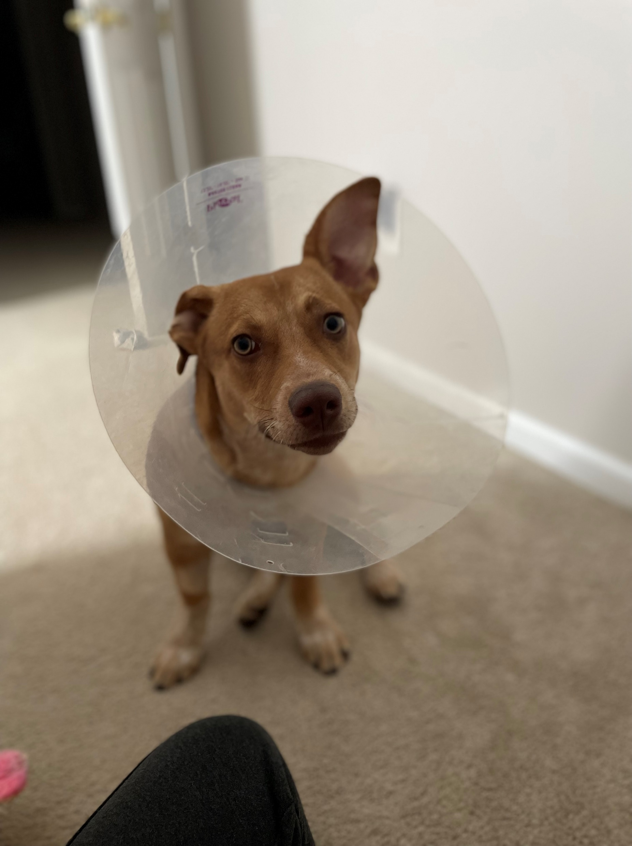
I spend more parts of my morning getting ready for work and giving my puppy some attention.

Slide 4
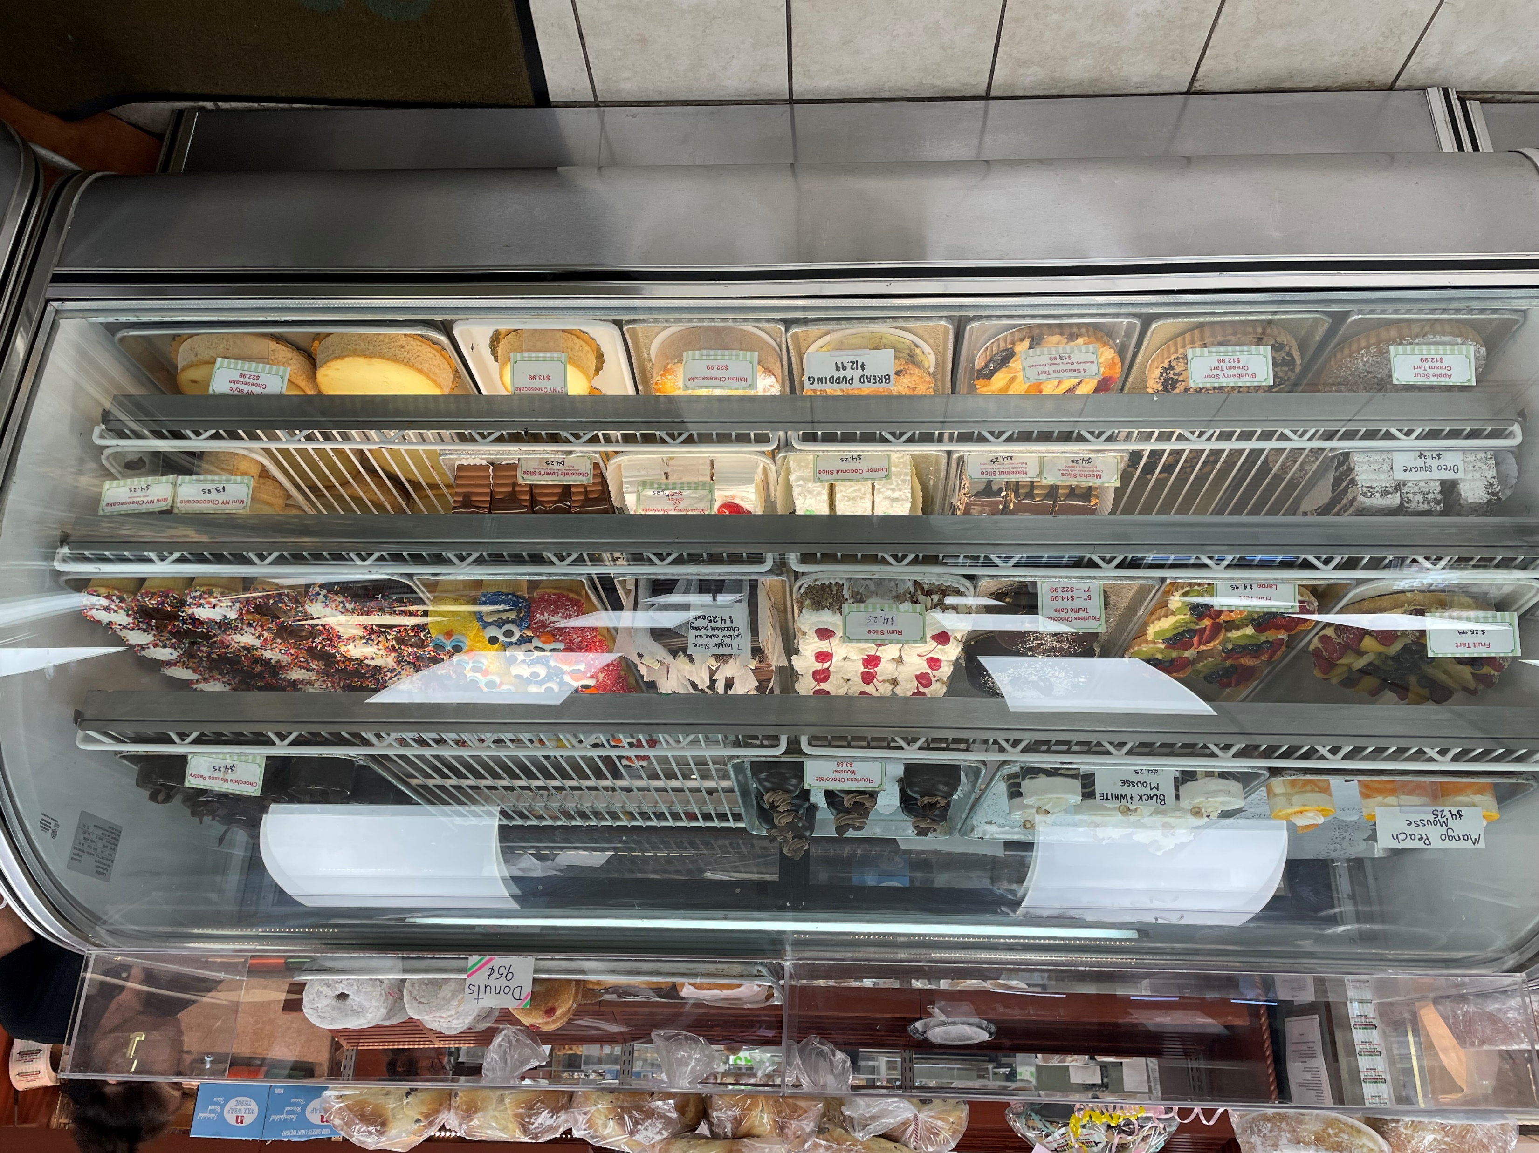
I head to work and work for about 8 hours and then it is time to go home.

Slide 5
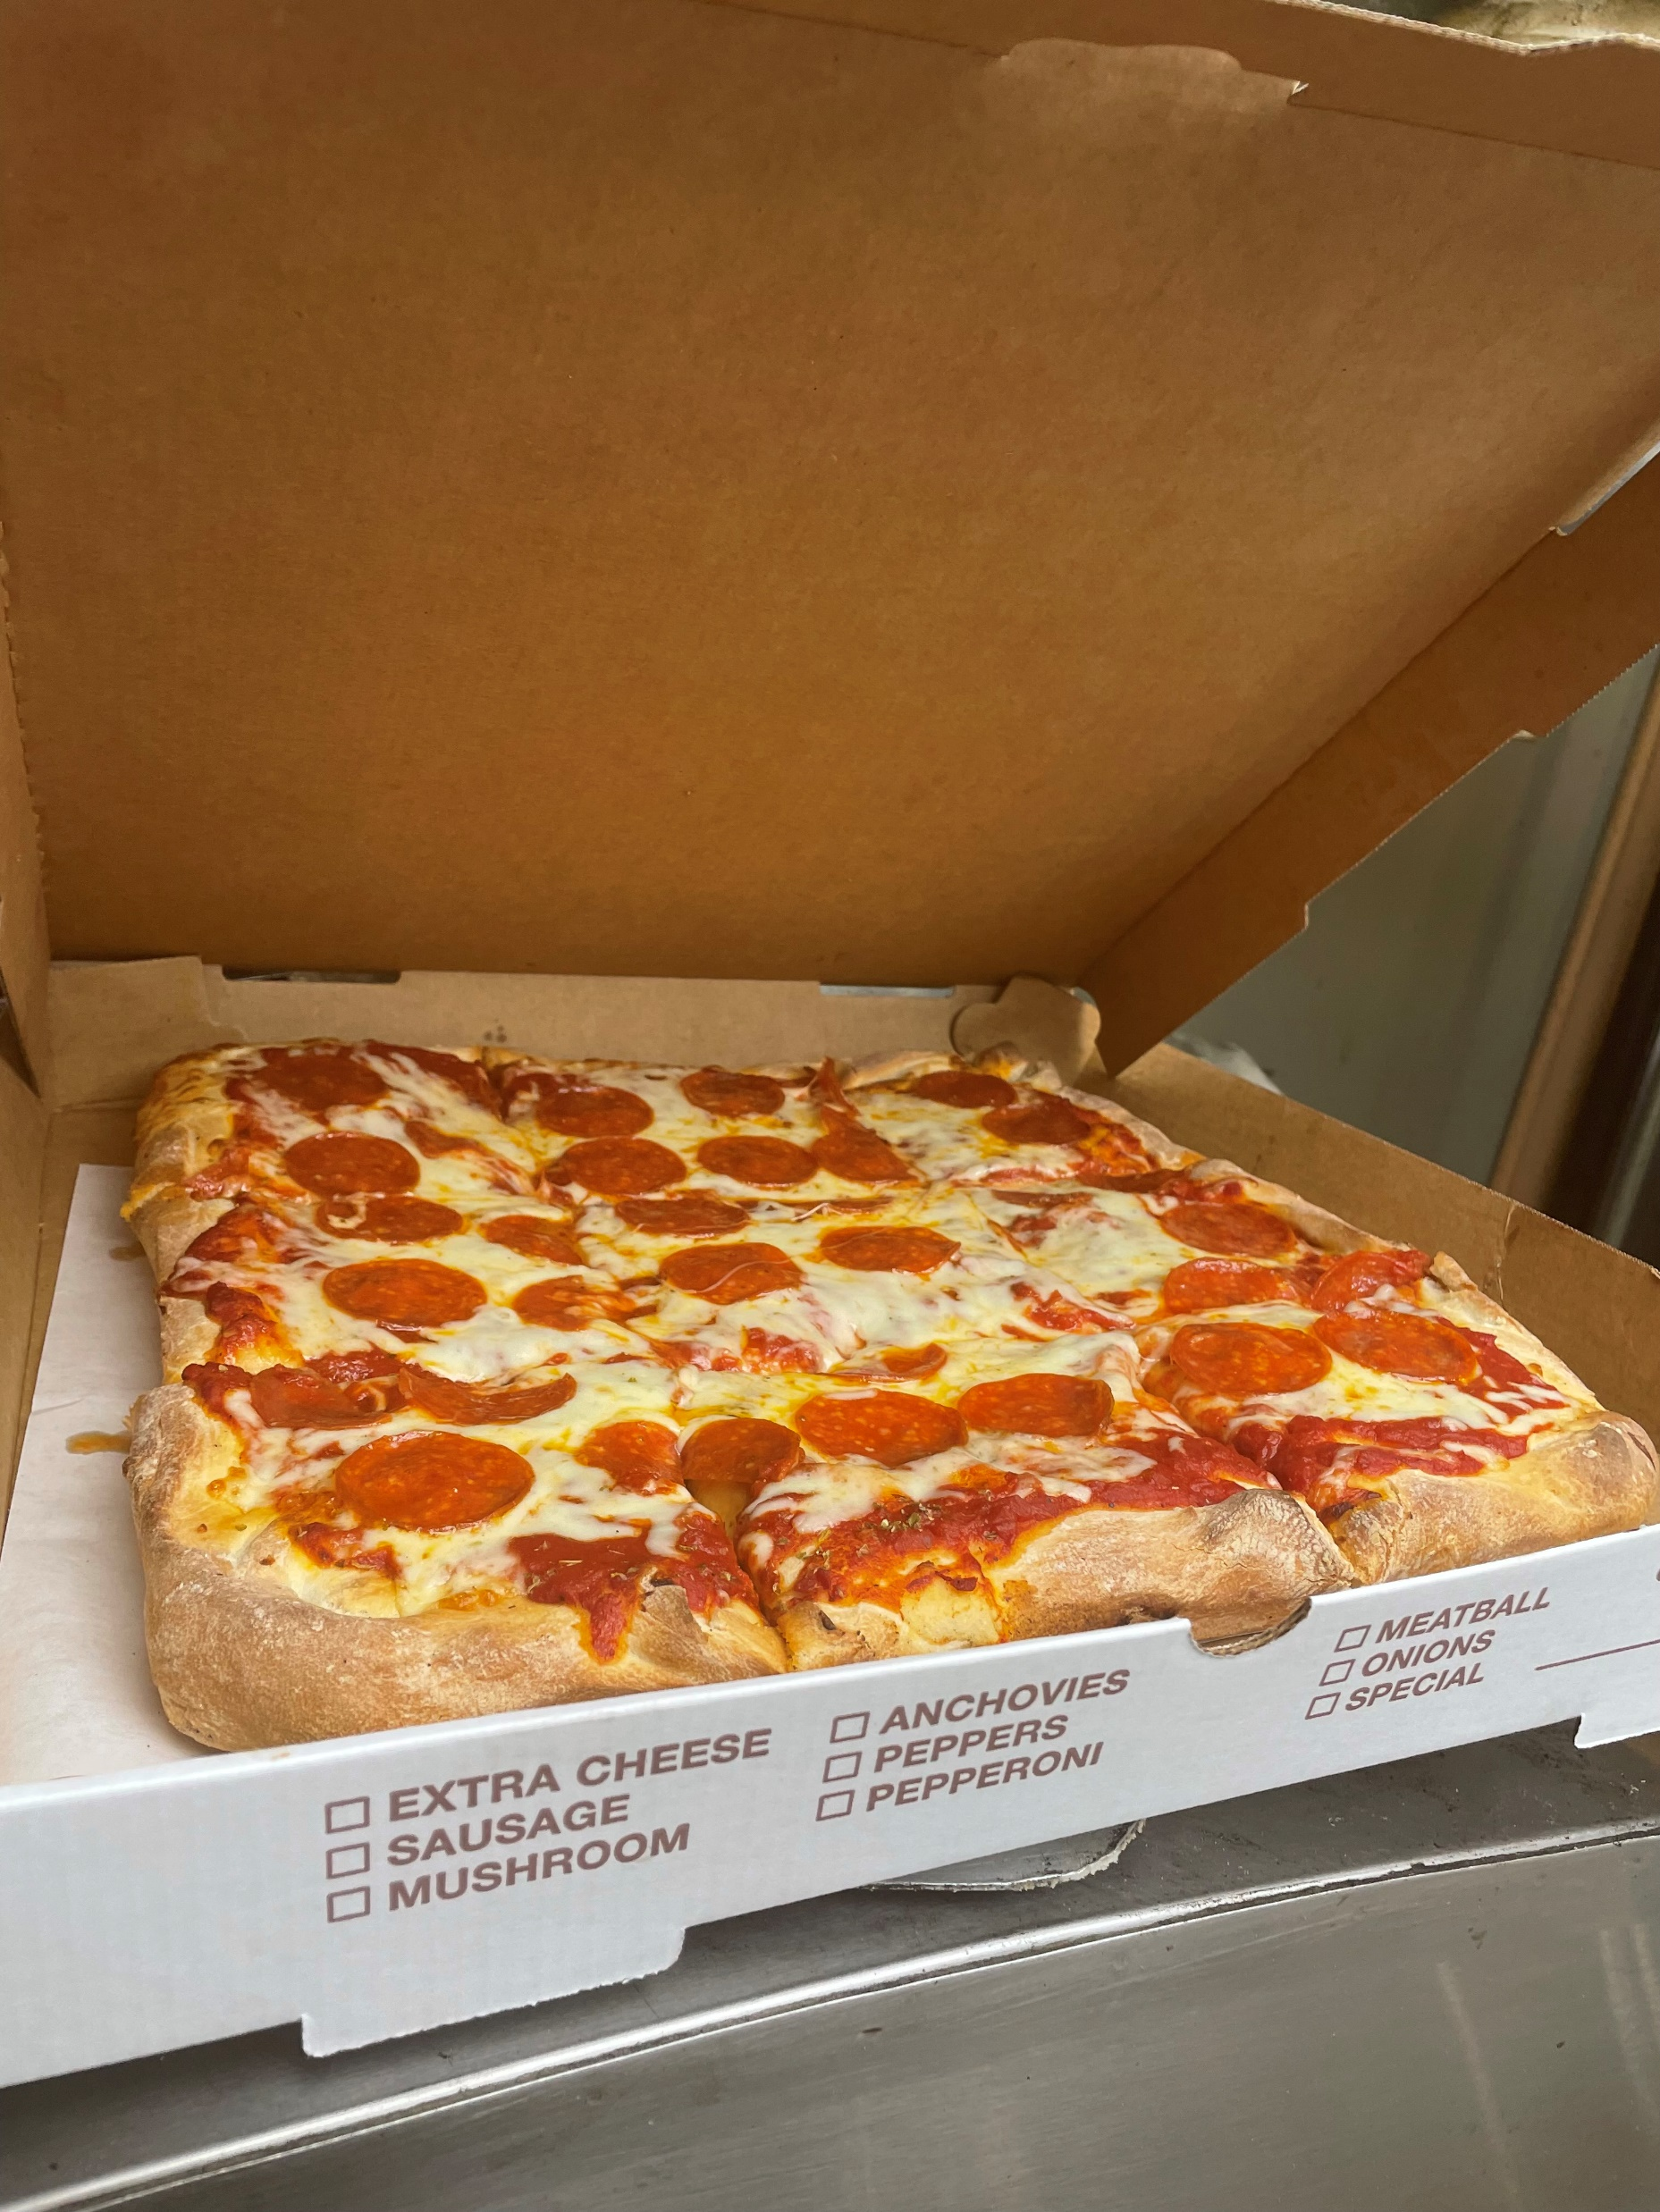
I make pizza and decorate cakes for hours on end.

Slide 6
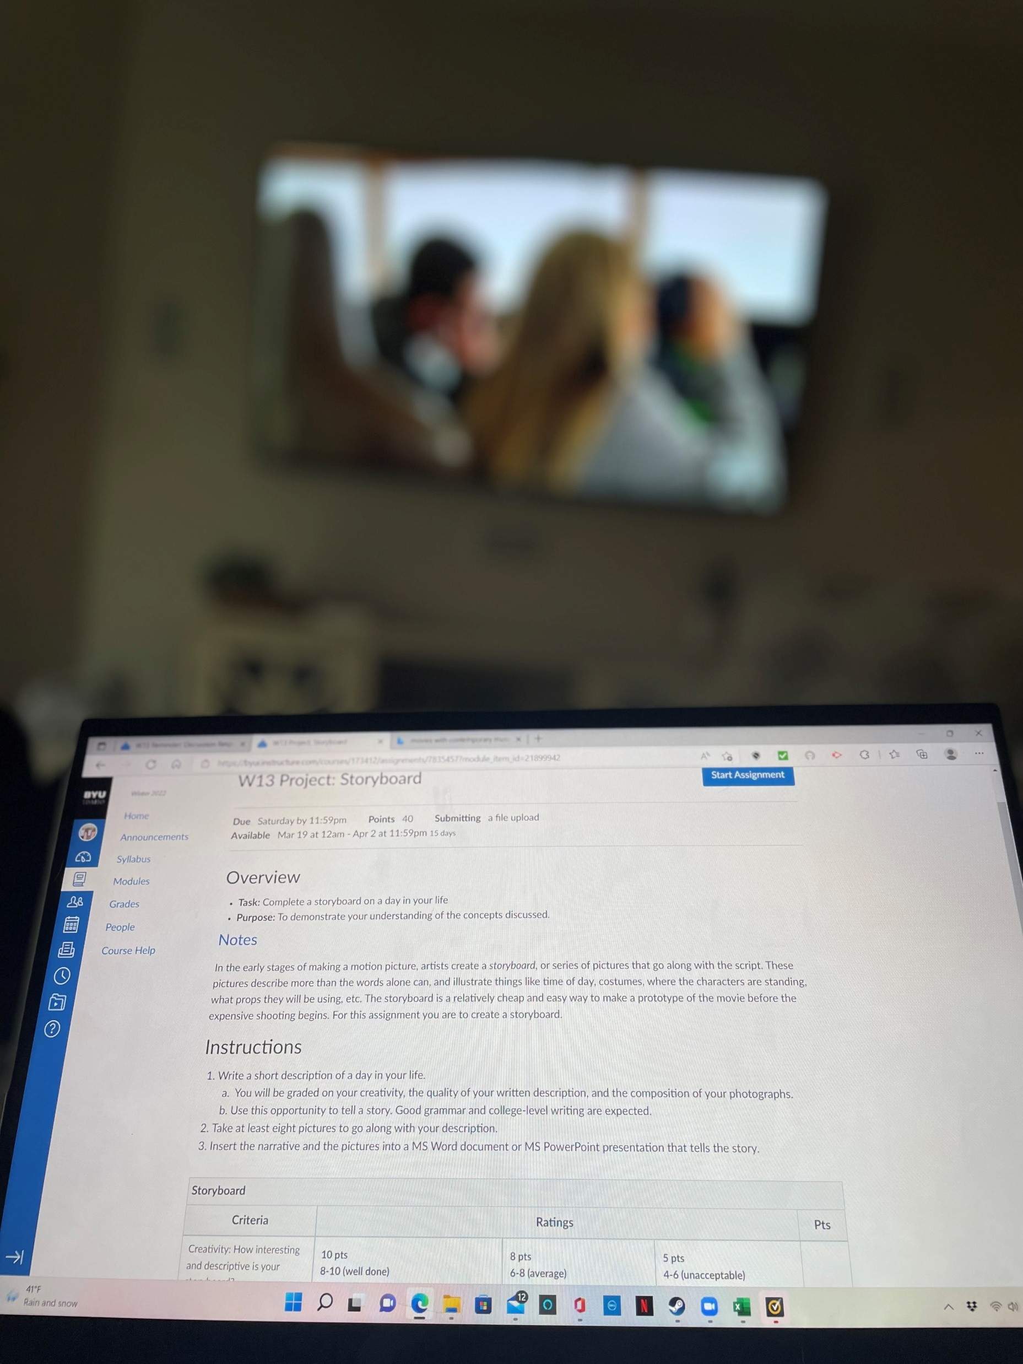
I immediately shower to wash off the day. I eat dinner with my family and cuddle with my dog some more. I do homework while I watch tv and sit there for hours.

Slide 7
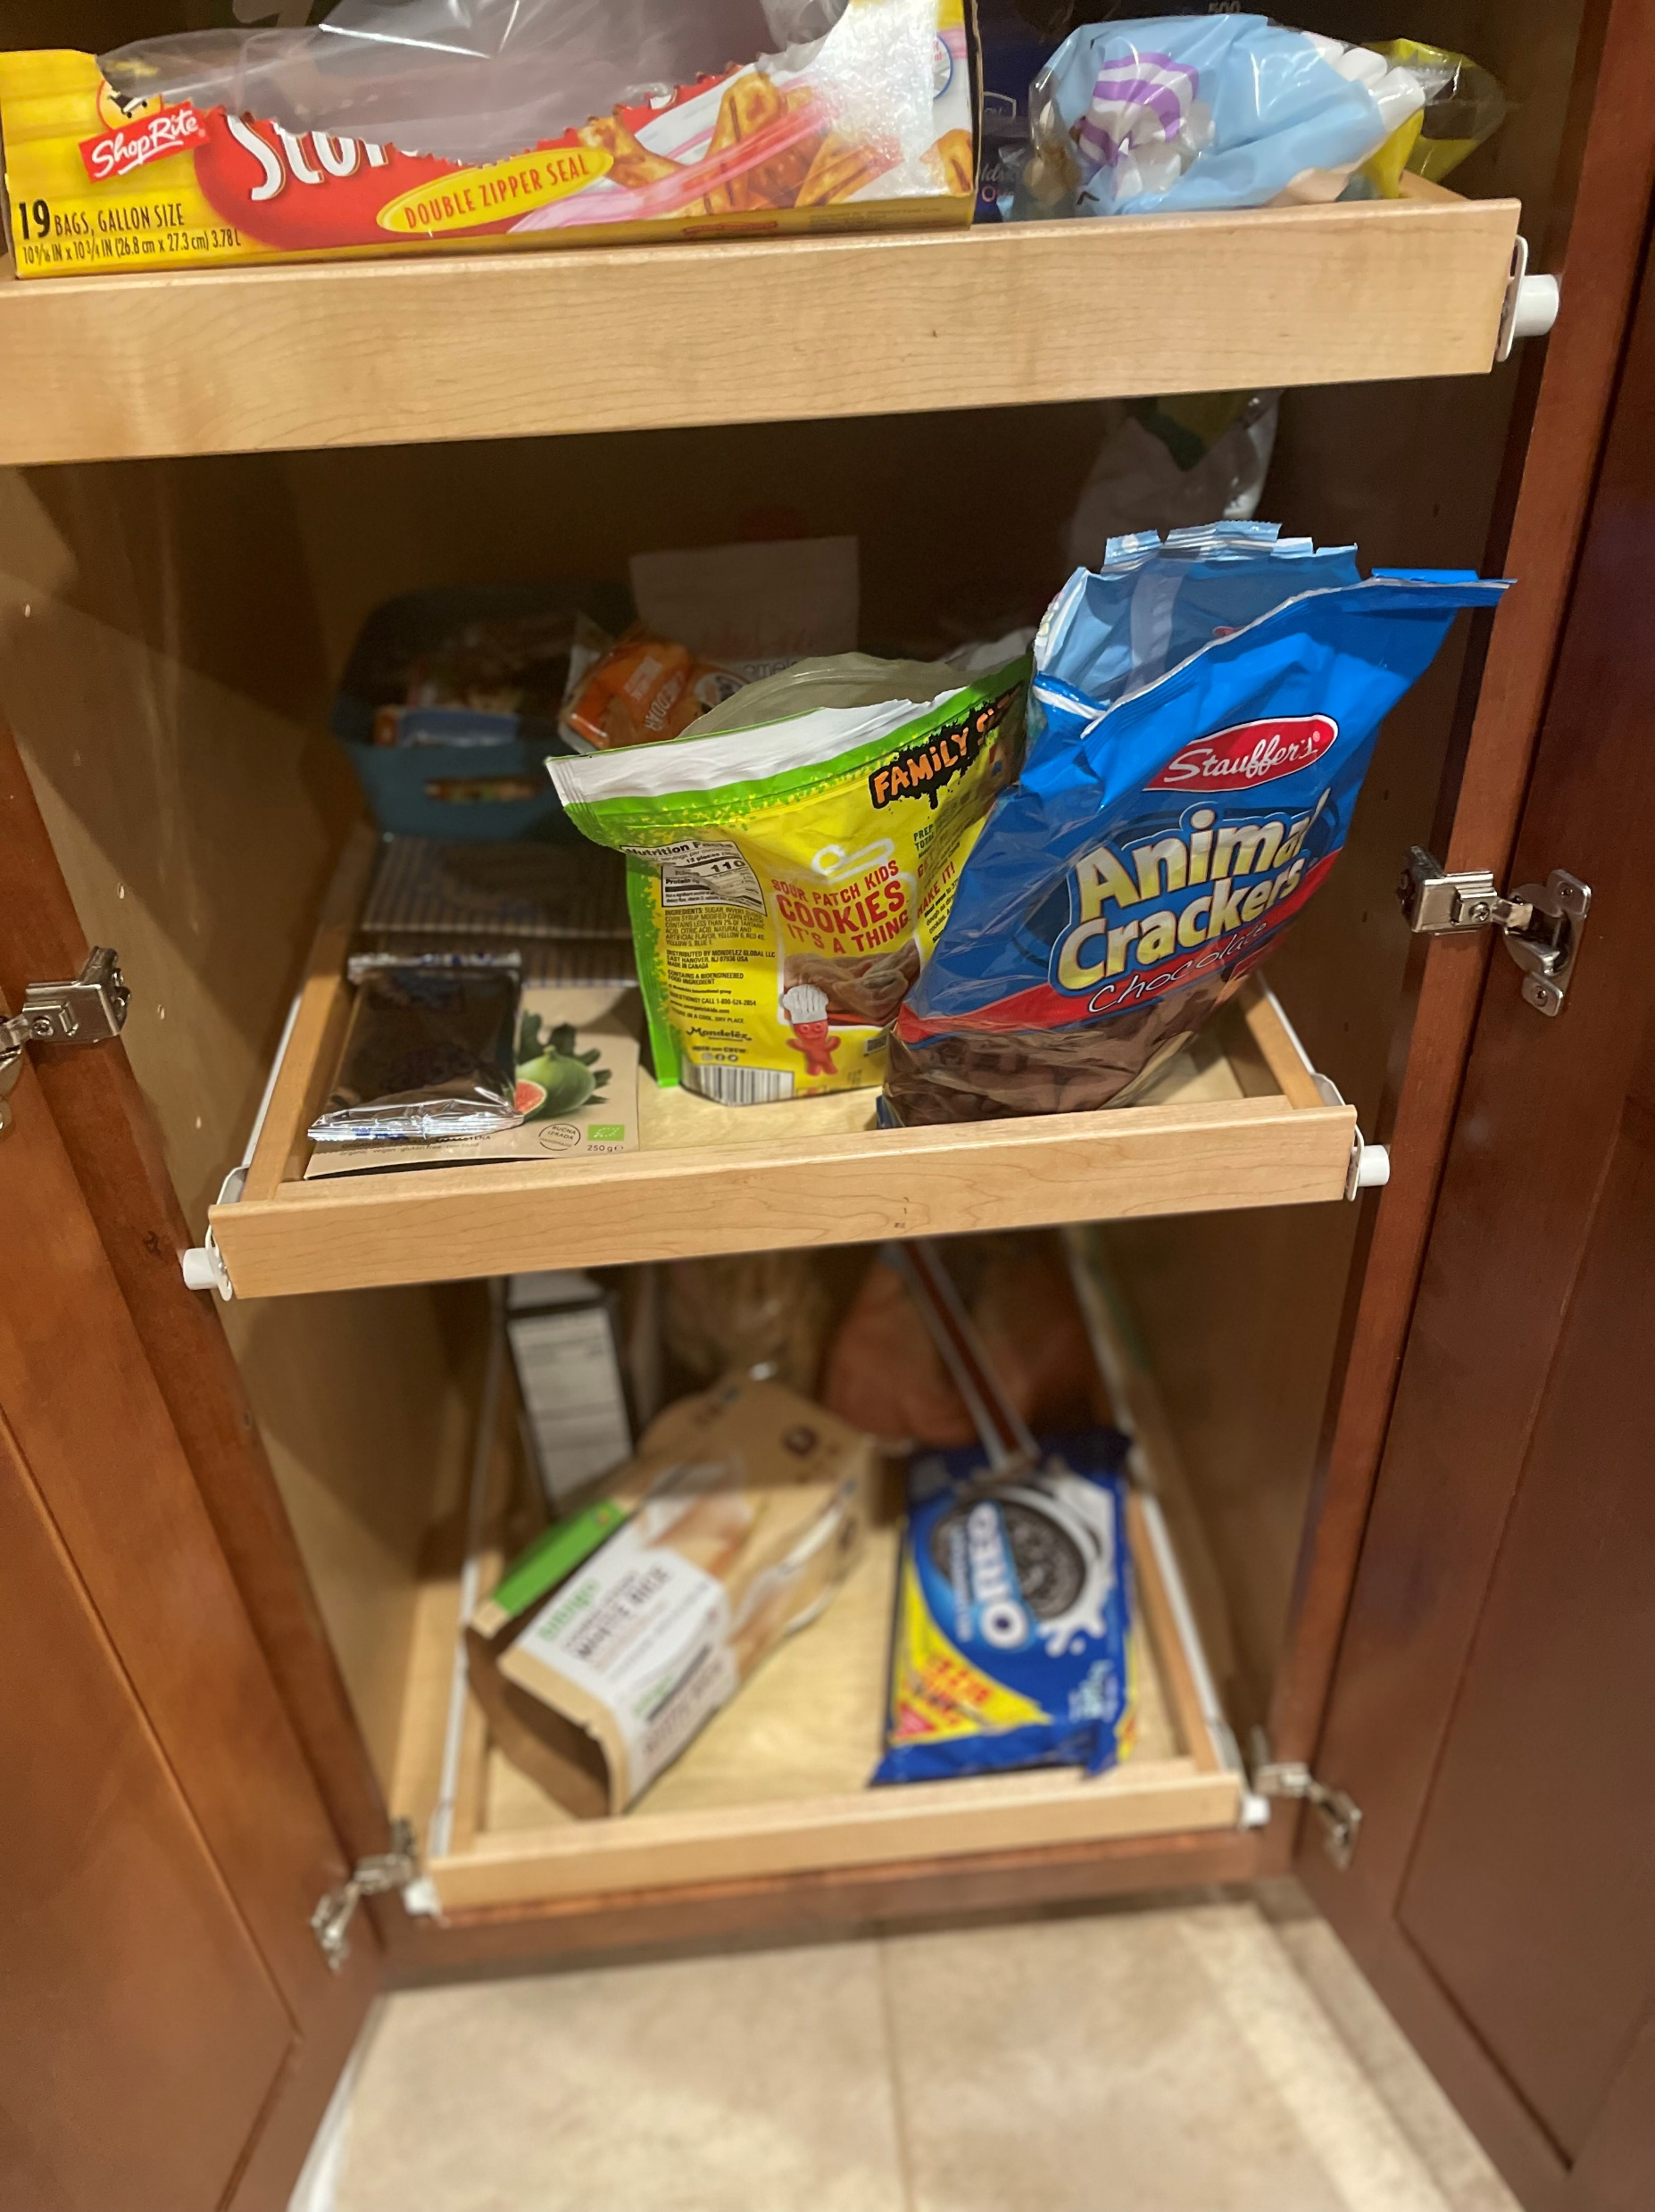
We come back and my boyfriend comes over to watch Jeopardy and Wheel Of Fortune with me. We watch other shows and eat plenty of snacks.

Slide 8
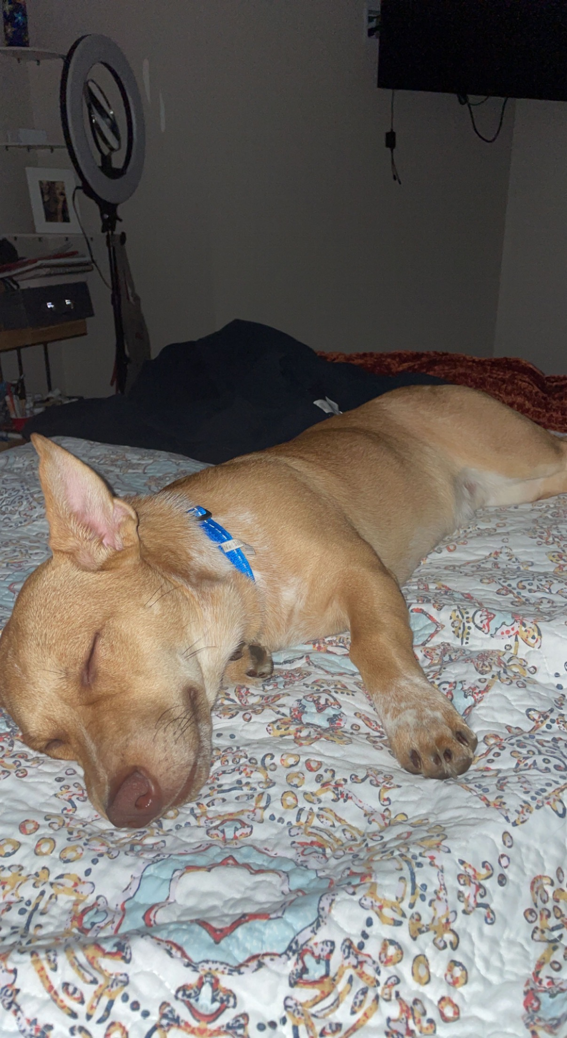
Then I say goodbye to my boyfriend and head upstairs and get ready for bed. I brush my teeth and take off my make up. I lay in bed with my dog and scroll on social media on my phone. I then decide to go to sleep once my eyes feel tired.

